Slide 1
Software Quality Assurance
Software Reliability
Dr. Seemab Latif
Lecture No. 16
6th January, 2011

Slide 2
What is Reliability?
The concept of reliability is very broad, and it can be applied whenever someone expects something or someone else to “behave” in a certain way.
For example, a lighting switch is expected to stay in one of two states—on and off—as set by its user. If a lighting switch causes a lamp to flicker even when the power supply is stable and the connecting cables are fault free, we say that the switch has turned unreliable.
Wear and tear have caused the switch to malfunction, and thus cause it to develop faults.
Therefore, the concept of fault is intertwined with the concept of reliability.

Slide 3
Software System Reliability
Reliability is one of the metrics used to measure the quality of a software system. It is arguably the most important quality factor sought in a product.
Reliability is a user-oriented quality factor relating to system operation, and it takes into account the frequency of system failure. Intuitively, if the users of a system rarely experience system failure, then the system is considered to be more reliable than one that fails more often.
Constructing a “correct” system, that is, a fault-free system, is a difficult task by itself given that real-life systems are inherently complex. The problem of constructing a fault-free system becomes more difficult when real-life factors are considered.

Slide 4
Fault and Failure
The notions of fault, failure, and time are central to our understanding of reliability.
In general, if a user never observes failures, the system is considered to be very reliable. On the other hand, a frequently failing system is considered to be highly unreliable.
A failure is said to occur if the observable outcome of a program execution is different from the expected outcome.
Two characteristics of failures are as follows:
failures are associated with actual program executions
failures are observable concepts

Slide 5
Fault and Failure
The adjudged cause of a failure is called a fault. While constructing a software system, a designer may mistakenly introduce a fault into the system.
A fault can be introduced by having a defective block of code, a missing block of code for an unforeseen execution scenario, and so on.
The mere presence of faults in a system does not cause failure. Rather, one or more defective portions of a system must execute for a fault to manifest itself as a system failure.
One fault can cause more than one failure depending upon how the system executes the faulty code [

Slide 6
Time
Time plays a key role in modeling software reliability metrics.
Let us go back to the concept of reliability of a lighting switch. Assume that a switch causes a lamp to flicker for a couple seconds, and let the average time gap between two successive flickers be six months. Here, flickering of the lamp can be considered as an observable failure of the switch. Though users may be irritated by such flickers, some may still consider the switch to be reliable because of the long time gap between two flickers. A time gap of six months can be considered to be long because a user may not remember when the lamp flickered last. However, if the lamp flickers a few times everyday, the switch appears less reliable and becomes a candidate for replacement. Thus, the notion of time is important in understanding the concept of reliability.

Slide 7
Time
There are two commonly considered time models in the study of software reliability:
Execution time (τ )
Calendar time (t )
Clock Time

Slide 8
Execution Time (τ )
The execution time for a software system is the actual time spent by a processor in executing the instructions of the software system. Sometimes a processor may execute code from different software systems, and therefore, their individual execution times must be considered separately
On the one hand, there are many software systems which are expected to run continuously for months and years without developing failure. Examples of such systems are telephone switching software, air-traffic control software, and software for monitoring power plants.
On the other hand, there are software systems which run for a while and terminate upon completion of their tasks. For example, a compiler terminates after compiling a program. Though the concept of software reliability can be applied to all kinds of software systems, the ones running continuously draw more attention.

Slide 9
Calendar Time (t)
Calendar time is the time more commonly understood and followed in everyday life by all, including software engineers and project managers.
Since observation of failures, fixing the corresponding faults, and replacing an old version of a software with a new one are intertwined in the life cycle of software systems, calendar time is useful for pragmatic reasons such as engineers leaving a company, engineers going on leave, and so on.

Slide 10
Clock Time
A third time model occasionally referred to is the clock time of a software system.
Clock time refers to the elapsed time between the start and the end of program execution. Clock time includes the wait time of the software system and execution times of other software systems. Clock time does not include system shutdown.

Slide 11
Failure and Time
In order to have a better understanding of the reliability of a software, one can ask the following questions in terms of failure and time:
What is the time interval between two successive failures?
How many failures have been observed within a certain time interval, for example, in the past one month or one year?
What is the total number of failures observed so far?

Slide 12
Time Interval between Failures
One can infer several characteristics of a software system by monitoring the time interval between successive failures as follows:
A small time interval between successive failures tells us that the software system is failing frequently, and hence the reliability level is too low. This can happen during system testing or even while the system is in operation. If the time interval between successive failures is long, the reliability is perceived to be high, in spite of the occasional system failure.
At the beginning of system-level testing, usually a large number of failures are observed with small time intervals between successive failures. As system testing continues and faults are actually fixed, the time interval between successive failures increases, thereby giving an evidence that the reliability of the product is increasing.

Slide 13
Counting Failures in Periodic Intervals
Useful information can be gathered by monitoring the cumulative failure count on a periodic basis.
For example, we record the cumulative failure count every month, plot it as a bar chart, and observe the pattern.
Such monitoring can be done during system testing as well as while a system is in operation.

Slide 14
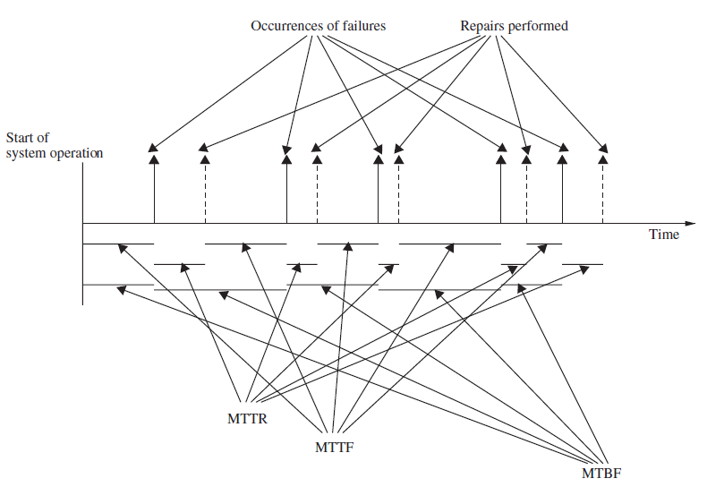
Counting Failures in Periodic Intervals
Relationship between MTTR, MTTF, and MTBF

Slide 15
Definitions of Software Reliability
There are two commonly used software reliability metrics, namely, the probability of failure-free operation and the failure intensity.
The concept of failure is common to both definitions. One metric is probabilistic in nature, whereas the other is an absolute one.
The two definitions are not contradictory. Rather, both can be simultaneously applied to the same software system without any inconsistency between them.

Slide 16
First Definition of Software Reliability
Definition. Software reliability is defined as the probability of failure-free operation of a software system for a specified time in a specified environment.
The key elements of the above definition of reliability are as follows:
Probability of failure-free operation
Length of time of failure-free operation
A given execution environment
Software reliability is expressed as a continuous random variable due to the fact that most large software systems do have some unknown number of faults, and they can fail anytime depending upon their execution pattern. Therefore, it is useful to represent software reliability as a probabilistic quantity.

Slide 17
Probability of Failure-Free Operation
One can specify the reliability of a software system running on a personal computer (PC) as follows. Assume that an office secretary turns on his or her PC every morning at 8.30 AM and turns it off at 4:30 PM before leaving for home.
The secretary expects that the PC will run for eight hours without developing any failure. If he or she comes to the office for 200 days in a year and observes that the PC crashes five times on different days in a year for a few years, we can say that the probability of failure-free operation of the PC for eight hours was 0.975 [=(200 − 5)/200].

Slide 18
Execution Environment
An execution environment refers to how a user operates a software system. Not all users operate a software system in the same way. As an example, let us consider the case of a word processor. One group of users may be processing documents of small size, say 50 pages. A second group of users may be processing documents of large size, say, 1000 pages. Clearly, the two groups of users offer two different execution environments to the word processor.

Slide 19
Second Definition of Software Reliability
Definition. Failure intensity is a measure of the reliability of a software system operating in a given environment.
According to the second definition, the lower the failure intensity of a software system, the higher is its reliability. To represent the current reliability level of a software system, one simply states the failure intensity of the system.
For example, let a software system be in its system testing phase where test engineers are observing failures at the rate of 2 failures per eight hours of system execution.
Then, one can state the current level of the reliability of the system as 0.25 failure per hour.

Slide 20
Factors Influencing Software Reliability
A user’s perception of the reliability of a software system depends upon two categories of information, namely,
the number of faults present in the software
the ways users operate the system.
The second category of information is known as the operational profile of the system. The number of faults introduced in a system and the developers’ inability to detect many of those faults depend upon several factors as explained on next slide

Slide 21
Factors Influencing Software Reliability
Size and Complexity of Code: The number of LOC in a software system is a measure of its size. Large software systems with hundreds of thousands of LOC tend to have more faults than smaller systems. The likelihood of faults in a large system, because of more module interfaces, is higher. The more number of conditional statements the code contains, the more complex the system is considered to be. Due to the economic considerations in software development, one may not have much time to completely understand a large system. Consequently, faults are introduced into the system in all its development phases. Similarly, while removing faults from a large system, new faults may be introduced.

Slide 22
Factors Influencing Software Reliability
Characteristics of Development Process: Much progress has been made in the past few decades in the field of software engineering. New techniques and tools have been developed to capture system requirements, to design software systems, to implement designs, and to test systems.
For example, formal methods, such as SDL (Specification and Description Language) and UML (Unified Modeling Language), are used to specify the requirements of complex, real-time systems. Code review techniques have been developed to detect design and implementation faults. Test tools are available to assist programmers in their unit-level and system-level testing.
By developing a system using above software engineering techniques and tools, the number of remaining faults in software systems can be reduced.

Slide 23
Factors Influencing Software Reliability
Education, Experience, and Training of Personnel: The information technology industry has seen tremendous growth in the past 20 years or so. It is not unusual to find many personnel with little training to be writing, modifying, and testing code in large projects. Lack of desired skills in personnel can cause a system to have a larger number of faults.

Slide 24
Factors Influencing Software Reliability
Operational Environment: Detection of faults remaining in a software system depends upon a test engineer’s ability to execute the system in its actual operational environment. If a test engineer fails to operate a system in the same manner the users will do, it is very likely that faults will go undetected. Therefore, test engineers must understand the ways the users will operate a system.
Because of a lack of sufficient time and lack of experience on the part of development and test engineers, faults can be introduced into a system, and those faults can go undetected during testing.

